Slide 1
Reminders:
Content Developed and owned by the AWS Partner Certification Readiness (APCR) team – may not be used or delivered outside of an authorized APCR Event delivery.
Do not suggest with guaranteed certification outcomes, or discuss pass rates with attendees.
Minimal content modifications are expected. Please highlight to the APCR team significant tailoring needs, OR any noted inaccuracies in the content. Improvement suggestions always welcome.
Have fun – You’re representing AWS. Our core goal is to get these individuals Certified, but your enthusiasm, engagement, and professional experiences are what keep them returning to the live sessions!
Notes:
FACILITATOR: Read this before anything else. It is hidden on purpose and it is the one slide that must not reach a partner.
Be sure this slide is hidden or removed prior to exporting a PDF for your partner.
Two constraints on the way you present: do not suggest a guaranteed certification outcome, and do not discuss pass rates. Both are on the slide and both are firm.
Minor tailoring is expected. Anything larger, or anything you believe is inaccurate, goes back to the APCR team rather than being fixed live.

Slide 2
Event Kick-Off
AWS Partner Certification Readiness
Developer - Associate
Notes:
WHAT'S HERE: The title slide. Hold it while people arrive and audio settles.
FACILITATOR: Introduce yourself briefly and say what you do at AWS, because your own delivery experience is a large part of why people come back to the live sessions rather than only watching recordings.
Set the shape of the hour out loud: what the certification is, how the five weeks run, what the exam is like, and then a walkthrough of account setup at the end.
Ask where people are joining from and whether anyone already holds an AWS Certification. It tells you how much of the certification-basics block to linger on.

Slide 3

Todays Learning Outcomes
Event Overview
About AWS Certifications
Exam Experience & Contents
Training Account Set-up
Notes:
WHAT'S HERE: The four blocks of this session, in the order they run.
FACILITATOR: This slide exists so nobody spends the hour wondering when the thing they care about arrives. Name all four, then say which one answers the question most people come in with -- usually the exam block.
Flag the last block explicitly: account setup is a live walkthrough and anyone already set up is free to leave at that point. Saying it early stops people sitting through it out of politeness.
Keep this short. It is a signpost, not a topic.

Slide 4
About AWS Certifications
Developer - associate
Notes:
WHAT'S HERE: Opens the certification block -- what the credential is, and who it is for.
FACILITATOR: Two slides follow: the certification portfolio as a whole, then this credential specifically. Frame the pair as answering one question -- is this the right exam for me right now.
Ask the room what they are hoping the certification does for them before you show the next slide. The answers split into career pivot and career advancement, which is exactly the split the credential slide uses, so their own words set it up.

Slide 5
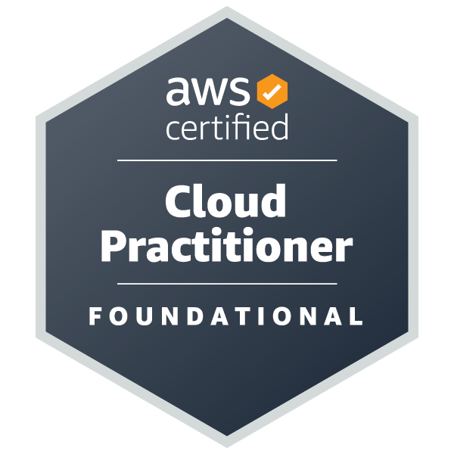
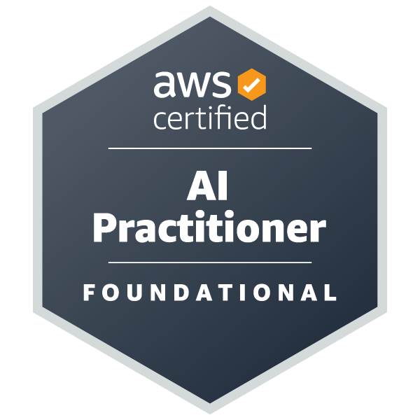
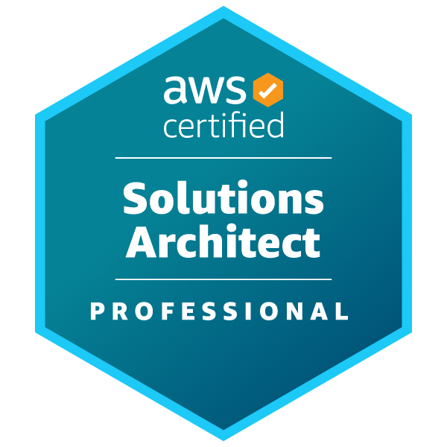
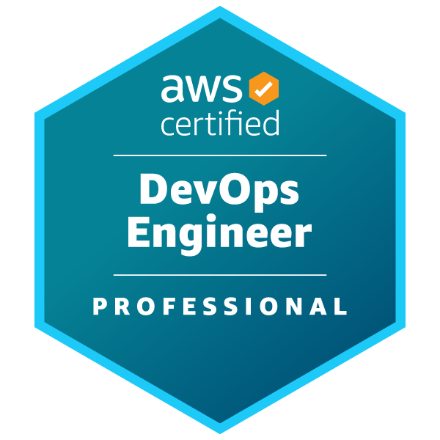
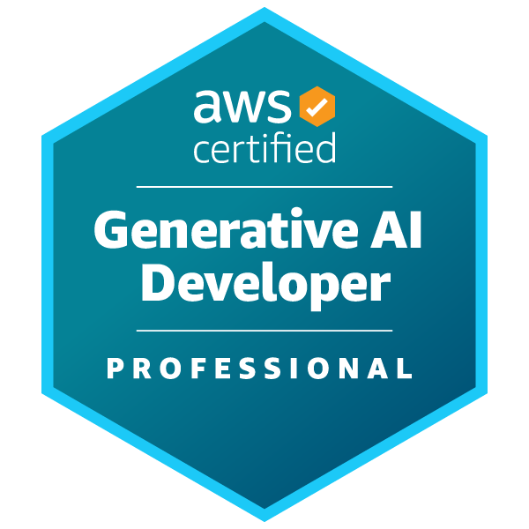
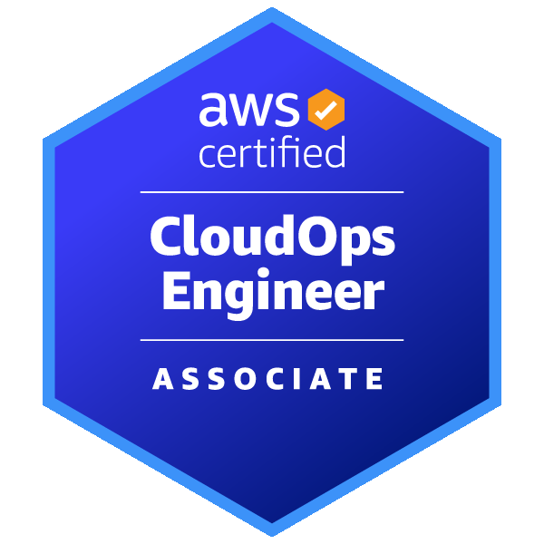

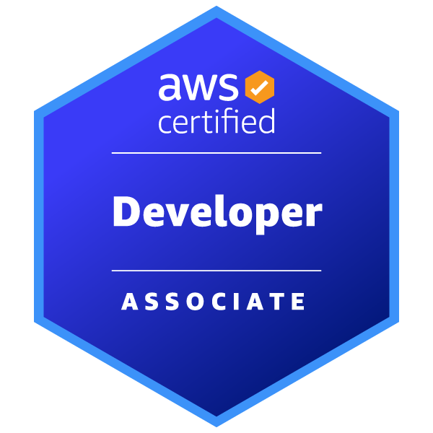
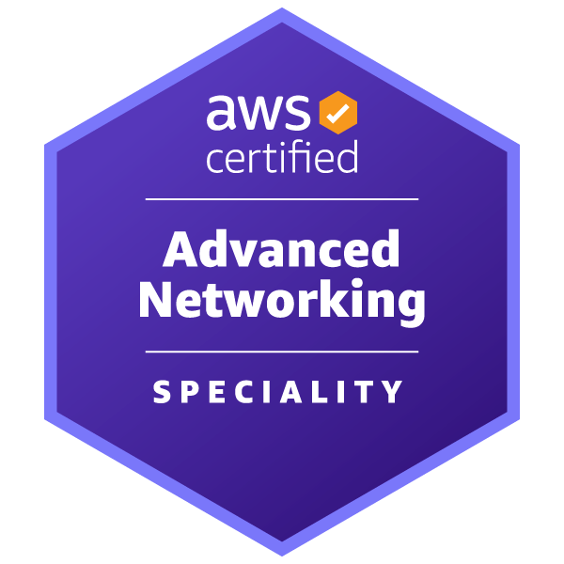



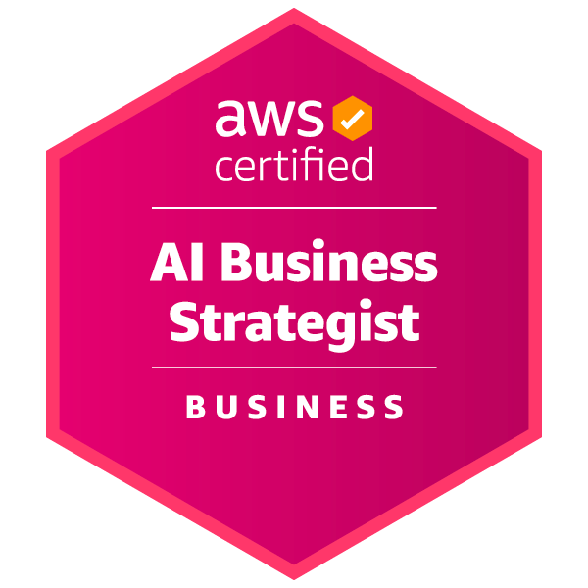
AWS Certifications: identify talent, drive business results
FOUNDATIONAL
PROFESSIONAL
Six months of fundamental AWS Cloud and industry knowledge
Two years of experience designing, operating, and troubleshooting solutions using the AWS Cloud
ASSOCIATE
One year of experience solving problems and implementing solutions using the AWS Cloud
SPECIALTY
Technical AWS Cloud experience in the Specialty domain as specified in the exam guide
BUSINESS
For professionals who shape the strategy, governance and adoption of technology alongside technical teams.
Notes:
We have 12 certifications, including the foundational Cloud Practitioner Certification, Associate-Level Solutions Architect, Developer, and Sysops, the Professional Level Solutions Architect and DevOps, and specialty certifications for Advanced Networking, Data Analytics, Security, Machine Learning, Database, and SAP on AWS.
Visit aws.amazon.com/certification to learn more about our certification program
Detailed notes:
With our AWS Certifications, we offer both role-based and specialty certifications.
With our role-based certifications, we validate the knowledge, experience, and skills someone needs to be successful in roles critical for organizations building with AWS. And at levels ranging from foundational knowledge to associate-level experience and advance to professional-level expertise.
From a Foundational perspective, many roles require broad cloud fluency and the AWS Certified Cloud Practitioner certification validates foundational AWS Cloud knowledge for the technical and non-technical.
At the associate level — at least one year of hands-on, real world experience with AWS, we offer certifications in the core functions of architecting, operations, and developing.
Solutions Architect — Associate — architecting and deploying well-architected systems on AWS to meet necessary requirements.
SysOps Administrator — Associate — deploying, managing, and operating systems on AWS.
Developer — Associate - writing and deploying cloud-based applications that follow AWS best practices.
And for those with significant expertise on AWS - our professional-level role-based certifications
Solutions Architect - Professional - validates expertise with the breadth of AWS services and how they work together within diverse, complex requirements.
DevOps Professional - validates expertise such as continuous delivery systems and automating operational processes.
Our Specialty certifications are for those with deep expertise within a specific topic area. For example —
Security, a critical skill set and expertise for any organization
Machine learning and Alexa Skill Builder - both launched earlier this year
AWS Certified Database — Specialty - validates deep expertise with the breadth of AWS database services and using them to fuel transformation.

Slide 6
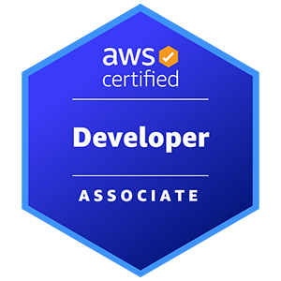
AWS Certified Developer - Associate
What it entails, and who it is useful for!
AWS Certified Developer - Associate showcases skills and knowledge in developing, optimizing, packaging, and deploying applications, using CI/CD workflows, and identifying and resolving application issues.
Applicable for professionals looking to–
Career Pivot: Create opportunities to move into a cloud role at your organization
Career Advancement: Validate your experience with AWS to advance your career
Notes:
WHAT'S HERE: What this certification validates, and the two audiences it serves.
FACILITATOR: The scope on the slide is AWS's own wording -- developing, optimizing, packaging and deploying applications, CI/CD workflows, and resolving application issues. Read it as a scope statement rather than a syllabus.
On audience, AWS recommends one or more years of hands-on experience developing and maintaining applications with AWS services. Anyone with no IT background is usually better served by Cloud Practitioner first, and it is kinder to say so now than at week four.
Two useful facts for planning: the certification is valid for three years, and holding any AWS Certification earns a 50% discount on the next one.
Verified against aws.amazon.com/certification/certified-developer-associate/

Slide 7
Event Overview
Developer - Associate
Notes:
WHAT'S HERE: Opens the event-logistics block -- what the five weeks ask of them.
FACILITATOR: This is the block where attrition is decided, so be concrete. Three slides follow: the weekly commitment, the optional subscription, and the voucher campaign.
Say plainly that the live sessions and the self-paced training are two different commitments and both are needed. People who treat the live hour as the whole course are the ones who fall behind by week three.

Slide 8
Weekly Event Summary
Event Task | Task Description | Modality
Attend Kickoff Session | We will cover Event basics and summarize your next 5 weeks of learning. | Scheduled Session
Complete Weekly Digital Training | Complete the Developer Associate Learning Plan throughout the course of this Event. Weekly expectations are reviewed in the live sessions and cataloged in your Event Guide. | Self-Paced Digital
Complete Exam Prep Plan (Optional) | Complete the Exam Prep Plan: AWS Certified Developer – Associate for domain based review and practice tests. Utilize AWS Cloud Quest: Severless Developer throughout for hands-on, lab based challenges. Requires AWS Skill Builder Subscription. | Self-Paced Digital
Attend Weekly Content Review & Exam Strategy Sessions | Experts from AWS will guide you through a review of key AWS services and concepts related to your digital training assignments. Sample, exam-like questions will be reviewed live with attendees, with the instructor sharing best practices for selecting correct answers. | Scheduled Sessions
Schedule Exam | It’s a pleasure supporting you on your AWS Certification journey! Best of luck on your exam! Schedule here. | Proctored Exam
Notes:
WHAT'S HERE: The weekly commitment as a table -- what to attend, what to complete, and which parts are self-paced.
FACILITATOR: Walk the Modality column rather than reading the descriptions. The point that has to land is that the scheduled session and the self-paced digital training are separate obligations.
Name the one optional row as optional, and say what it costs -- the Exam Prep Plan row and Cloud Quest need a Skill Builder subscription, which the next slide covers.
Point them at the Event Guide for the week-by-week expectations, so they have a written reference when this recording is behind them.
Ask whether anyone cannot make a particular week. Knowing early lets you point them at the recording rather than losing them.

Slide 9


OPTIONAL AWS Skill Builder Subscription
The Skill Builder subscription provides access to official AWS Certification practice exams, self-paced digital training content including open-ended challenges, self-paced labs, and game-based learning. Please note, the Skill Builder subscription is not required for this Accelerator Event.
Access the
Developer Associate Exam
Prep Plan
during this event.
Free digital training
skillbuilder.aws/learn
Individual subscription
skillbuilder.aws/subscriptions
Special features include:
600+ digital courses
Learning plans
10 Practice Question Sets
AWS Cloud Quest (Foundational)
AWS SimuLearn (Cloud Practitioner)
Everything in free digital training, plus:
AWS SimuLearn (200+ trainings)
AWS Cloud Quest (Intermediate – Advanced)
Official Practice Exams; Enhanced Exam Prep
Unlimited access to 1000+ hands-on labs
AWS Jam Journeys (lab-based challenges)
AWS Digital Classroom (Annual only)
AWS Cloud Quest
Recommended for additional lab work
Individual subscriptions are priced at $29 USD per month (Flexibility to cancel anytime) or $449 USD per year.
Notes:
WHAT'S HERE: The optional Skill Builder subscription, and what the free tier already covers.
FACILITATOR: Lead with the sentence on the slide -- the subscription is NOT required for this event. Some attendees are self-funding and will read any paid row as a barrier.
Then be specific about what it unlocks, because two things in this program sit behind it: the official practice exam and Cloud Quest. Everything in the assigned learning plan is reachable without it.
If someone asks whether their company already has it, that is worth answering live -- a Team Subscription changes how they sign in, which is the account-setup block at the end.
Do not describe the subscription as necessary for certification. It is not, and the program is built so that it is not.

Slide 10
Promotional Campaigns available to YOU
Exam Vouchers
Opportunity to receive exam voucher
Event attendees may receive an exam voucher* if they:
Complete more than 50% of the assigned self-paced digital learning plan by the final week of the Event
Attend more than one (1) live session of the Event.
*Terms and conditions apply, while supplies last.
Notes:
(Instructor note – Read the Terms and Conditions, these will answer most any question you receive).
Unhide this slide if you’re delivering a PUBLIC Event. Hidden for Private deliveries only.
Occasionally AWS runs promotional campaigns for individuals to receive exam or service discounts.
Today we’re excited to announce that AWS Partner attendees of the AWS Partner Certification Readiness Events will have an opportunity to receive discounted exam vouchers. To qualify, you will need to complete more than 80% of the assigned self paced digital training in AWS Skill Builder (the free learning plan!). You must also attend at least one live session of the Event.
Please see the terms and conditions for full details. Vouchers will be assigned by the APCR Event management team automatically, and you will be notified upon delivery. Please refrain from asking the instructor and filling chat with voucher questions, the APCR Event team is managing this in the background.
Additionally, until September 30, 2026 you can get 50% off of your first 3 months subscription to AWS Skill Builder. Terms and conditions apply, while supplies last.

Slide 11
Week 1 Digital Training Curriculum
Progress check and reminder! Do your best to complete this week’s training content
AWS Skill Builder Learning Plan Courses
AWS Technical Essentials
AWS Compute Services Overview
Build with Amazon EC2
Exam Prep Plan (Optional)
Start: AWS Cloud Quest: Serverless Developer*
Review: Exam Prep Plan Overview
Complete: Domain 1 Review
Complete: Domain 1 Practice*
Complete: Domain 1 Practice: AWS Simulearn*
* Requires AWS Skill Builder Subscription
Notes:
Speaker Notes:
Use this slide as a check-in with the audience. See how they’re doing with the material. Relate to them with your own experiences studying for the exam, and discuss any of your own insights about the training modules. Which stood out to you? What key takeaways did you have from some of these trainings?
Note – Expect some people to have fallen behind. Show the empathy and encourage they keep at it!
Companion learning plan is the subscription based, partner learning plan aligned to the cert. Remind people of the value in CloudQuest, share what you like about it, benefit of the labs, etc. Check in with the audience to see if they’ve done any of the labs.

Slide 12
Exam Experience & Contents
Developer - associate
Notes:
WHAT'S HERE: Opens the exam block -- the mechanics, then the domain weightings.
FACILITATOR: This is the block most attendees came for, so give it room. Two slides follow: what sitting the exam is actually like, and what it covers.
Ask who has already sat an AWS Certification exam. Anyone who has will answer the remote-versus-testing-center question better than you can, and it costs you nothing to let them.
Hold the domain percentages until the next slide. People fixate on them, and the mechanics land better before the numbers arrive.

Slide 13
Taking the exam
130 minutes in duration
65 Questions (50 Scored questions)
Scored from 100 to 1,000 (720+ to Pass)
Multiple choice: one correct response of four
  Multiple response: two or more correct of five or more
  No Negative points or Partial credit
In-Person and Remote options available
Live proctor during exam
$150 USD
Notes:
WHAT'S HERE: The exam mechanics -- duration, format, scoring, and how it is delivered.
FACILITATOR: The two numbers people plan around are 130 minutes and 150 USD, so say both clearly. Delivery is either a Pearson VUE testing center or an online proctored exam, and a live proctor is present either way.
On format, the exam has 65 questions of which 50 are scored. The other 15 are unscored and are not identified during the exam, which is why a question that feels strange is not worth dwelling on.
On scoring, results are a scaled score from 100 to 1,000 with 720 to pass. There is no penalty for guessing, so an unanswered question is simply wrong -- tell them to answer everything.
One point worth making out loud: scoring is compensatory, so they do not need to pass each domain individually, only the exam overall.
Verified against the September 2026 certification updates blog and aws.amazon.com/certification/certified-developer-associate/

Slide 14
AWS Certified - Associate Exam Domains
DVA-C02 is in use until November 30, 2026 · DVA-C03 begins December 1, 2026
DOMAIN
DVA-C02
DVA-C03
1
Development with AWS Services
32%
30%
2
Security
26%
26%
3
Deployment · Testing and Deployment
24%
22%
4
Troubleshooting and Optimization
18%
22%
Notes:
WHAT'S HERE: The domain weightings for both versions of the exam, with the dates each one is in use.
FACILITATOR: Say which exam they will actually sit before reading any percentage. DVA-C02 is in use until November 30, 2026 and DVA-C03 begins December 1, 2026, so anyone testing in the next few months sits C02.
Then say what this program teaches: the five content sessions are built to C03, and each one carries an appendix covering the C02 difference for that week. Nobody is left without a reference for the exam they are booking.
The shape of the change is small and worth naming: Security stays at 26%, Development drops slightly, Troubleshooting and Optimization grows, and C03 renames the deployment domain to Testing and Deployment.
The one genuinely new thing in C03 is a task on the security of using AI services in application development. Week 5 covers it, so mention it here and move on.
Registration for C03 opens October 27, 2026.
Send anyone who wants the detail to the exam guide for the version they are sitting -- it lists every task and the in-scope services per domain, which is more useful to them than any percentage on this slide. This slide links the announcement blog; the DVA-C02 exam guide itself is at https://d1.awsstatic.com/training-and-certification/docs-dev-associate/AWS-Certified-Developer-Associate_Exam-Guide.pdf
Verified against the September 2026 certification updates blog.

Slide 15
Account Set-up Demo
(Feel free to drop off if you’re already set-up!)
Developer - Associate
Notes:
NOTE – Be sure to preface this section by identifying to the audience that many of them may have already set-up their accounts prior to joining. For those who did, they can feel free to drop off the call now.
For everyone who hasn’t, feel free to stay and follow-along. Once you’ve gotten your account set-up and accessed the Learning Plan, then feel free to drop off.
The goal here is to filter down until the attendees remaining are just those encountering the issues with account set-up.
How to set-up APN Account
How to set-up Skill Builder Account
Learning Plans path page

Slide 16
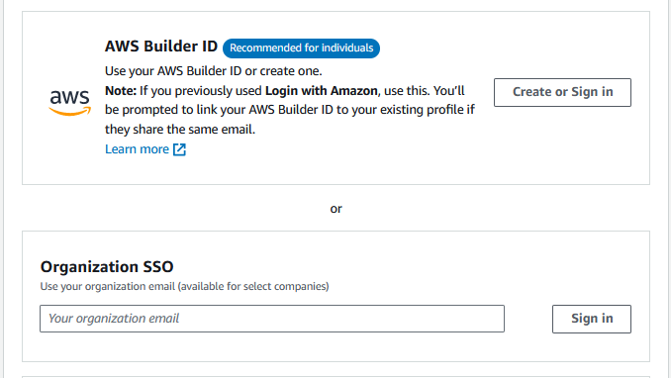

AWS Skill Builder Access
Access digital training and official practice question sets
Utilize for digital training resources.
Login as AWS Builder ID using account created with company email
Utilize for assigned digital learning plan
Utilize for official question sets and labs
Explore and learn!
Click here!
Notes:
WHAT'S HERE: How to reach the assigned learning plan, and which identity to sign in with.
FACILITATOR: This deck is the AWS Builder ID variant. They create an AWS Builder ID with their company email address and sign in with it.
If that does not match the room you are in, you are presenting the wrong variant -- stop and switch. The identity they start with is the one their whole training history attaches to.
AWS Builder ID is the standard login, unless your company has purchased team subscriptions and has SSO enabled.
Share the page on screen rather than reading the link aloud, and have them confirm they can see the assigned learning plan before you move on. A sign-in problem found now costs two minutes; found in week two it costs them a week.
The official question sets and labs live in the same place, which is worth pointing at even for anyone not planning to use them yet.

Slide 17
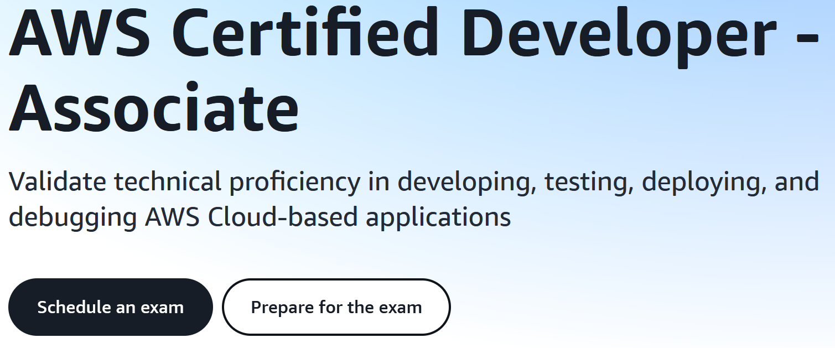
Exam Registration
Set-up your AWS Certification account and register early!
Bookmark the exam page – lots of resources!
Access CertMetrics through the exam page
Recommended to register with your company AWS Builder ID
Schedule early and give yourself a deadline
Click here!
Notes:
WHAT'S HERE: Setting up the certification account and booking the exam.
FACILITATOR: Two separate things happen here and people conflate them. Bookmarking the exam page gives them the resources; CertMetrics is where the account and the booking live, and it is reached through that page.
Register with the same AWS Builder ID they use for Skill Builder, so the training history and the exam record sit against one identity.
Push the scheduling point harder than it looks on the slide. Booking a date early is the single strongest predictor of finishing, because it converts an intention into a deadline. Ask them to pick a target week before the next session.
Registration for the updated DVA-C03 exam opens October 27, 2026, so anyone deliberately waiting for that version should plan around it rather than booking now.

Slide 18
Connecting your Certification
Be sure to SHARE your certification with your employer
AWS Partner tiers, benefits, and some promotional credits are awarded based on AWS Certifications attained by employees.
In your AWS Skill Builder account, access the Profile (top right, “Account”)
EDIT the profile and add the email used to sit for your exam under the “AWS Training and Certification badges” section
Email address needs to be verified, and can be changed as needed
Notes:
WHAT'S HERE: Linking the certification to their employer once they pass.
FACILITATOR: This slide is easy to skip and it is the one with a direct business consequence -- AWS Partner tiers, benefits and some promotional credits are awarded on the certifications a company's employees hold. A pass that is never linked does not count toward any of it.
Walk the actual path on screen: in Skill Builder, open Account at the top right, edit the profile, and add the email address used to sit the exam under the certification badges section.
The trap is the email address. It has to be the one on the exam record, which is not always the one they use day to day -- and that is why the identity decision two slides ago matters.
Ask them to do it the day they pass rather than adding it to a list.

Slide 19
Q&A Time!
AWS Partner Certification readiness
Notes:
FACILITATOR: Open the floor. Expect three kinds of question at a kickoff: logistics about the weekly commitment, cost questions about the subscription and the exam, and sign-in problems from the setup walkthrough.
For anything you cannot answer, say so and route it -- the Event Guide covers the weekly expectations and the APCR team takes content questions. Guessing at a policy answer is worse than deferring it.
If the room is quiet, ask who has already booked a date. It usually restarts the conversation and it reinforces the point from the registration slide.

Slide 20
Thanks for joining!
AWS Partner Certification readiness
Notes:
FACILITATOR: Close by naming what happens next rather than only thanking them. The first content session is next week, and the week-one training is available now.
Repeat the two actions that matter before then: start the assigned learning plan, and pick a target exam date. Everything else in this session was context for those two.
Thank them for the questions specifically. The discussion is what makes the live session worth more than the recording, and saying so makes the next one better attended.

Slide 21
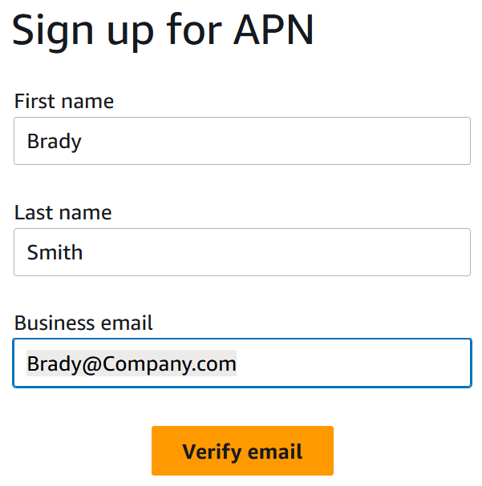
AWS Partner Network (APN) Account
Access AWS Partner exclusive training & Link your certification
This Event is designed for AWS Partners.
Register to APN with your company email.
Link your AWS Certification to this profile.
Use your APN credentials to access exclusive AWS Partner Training resources
Click here!
Notes:
WHAT'S HERE: Registering an APN account, for a room of AWS Partner employees.
FACILITATOR: This slide is hidden by default. Unhide it only when the audience is AWS Partner employees who need the partner-exclusive training, and present it alongside the certification-linking slide rather than instead of it.
Two actions on the slide and both matter: register with the company email address, then link the AWS Certification to that profile. The link is what makes the certification count toward the partner relationship.
If you are unsure whether it applies to your room, leave it hidden. Nothing later in the program depends on it.

Slide 22
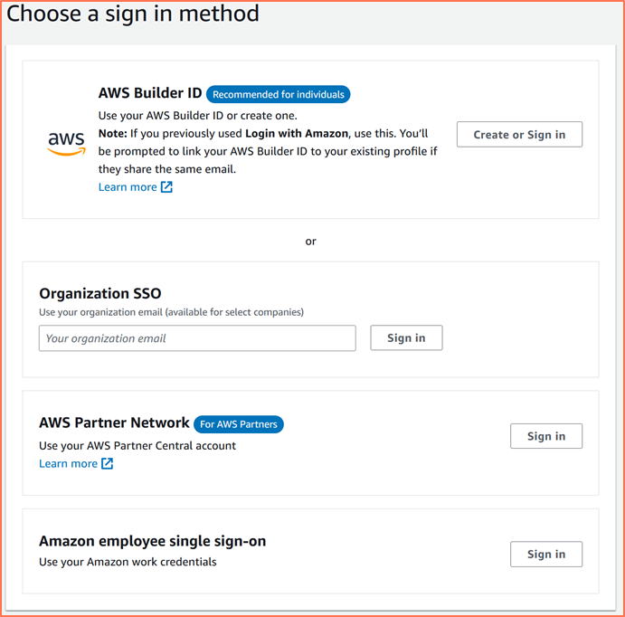
AWS Skill Builder Access
Access digital training and official practice question sets
Utilize for additional training resources.
Login as AWS Partner using APN credentials
Utilize for supplemental materials
Utilize for official practice question sets
Explore and learn!
Click here!
Notes:
WHAT'S HERE: Reaching training resources with APN credentials -- the partner-specific route to Skill Builder.
FACILITATOR: Hidden by default, and it pairs with the APN registration slide before it. Use both or neither.
Be explicit that this is a SUPPLEMENT rather than a replacement. The assigned learning plan for this event lives behind the identity on the main access slide; this route adds partner materials on top of it.
If someone signs in here expecting to find the event's learning plan, they will not, and that is the confusion this note exists to prevent.

